Slide 1




A solenoid of radius r and length l ( ) is uniformly wound with n turns. A square coil of side length a and N turns is placed around it, near its center. The current in the solenoid is changing at a rate of dI/dt = α .
(a) What is the current induced in the coil (resistance R) ? (Hint: remember the B field outside the solenoid is zero). (b) If the current in the solenoid changes from 0 to I_{s} what is the charge q that flows through the circuit ? (Hint: how is charge related to current ?)
$$a$$
$$ℰ=−\frac{dΦ}{dt}=−A\frac{dB}{dt}=−{πr}^{2}μ_{0}\frac{n}{l}α$$
$$V=N\left|ℰ\right|=N{πr}^{2}μ_{0}\frac{n}{l}α$$
B
$$I=\frac{Nn{πr}^{2}μ_{0}α }{Rl}$$
$$Q=I∆t=\frac{Nn{πr}^{2}μ_{0}α∆\text{t} }{Rl}=\frac{Nn{πr}^{2}μ_{0}I_{s} }{Rl}$$

Slide 2
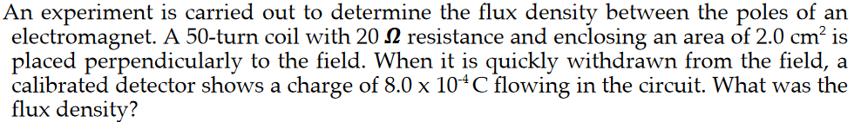




$$ℰ=−N\frac{dΦ}{dt}=−NA\frac{∆B}{∆t}$$
$$I=\frac{ℰ}{R}=\frac{NA∆B}{R∆t}$$
$$Q=I∆t=\frac{NA∆B}{R}$$
$$∆B=B−0=\frac{QR}{NA}=1.6 T$$

Slide 3
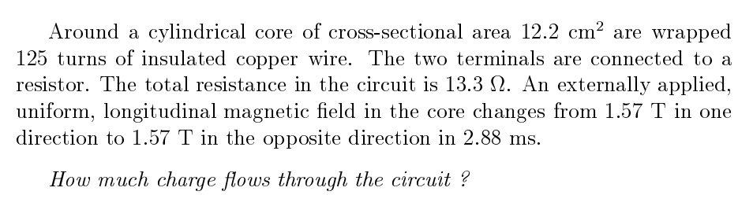





$$ℰ=−N\frac{dΦ}{dt}=−NA\frac{∆B}{∆t}$$
$$I=\frac{ℰ}{R}=\frac{NA∆B}{R∆t}$$
$$Q=I∆t=\frac{NA∆B}{R}$$
$$∆B=B−\left(−B\right)=3.14 T$$
$$Q=\frac{NA∆B}{R}=0.036 C$$

Slide 4
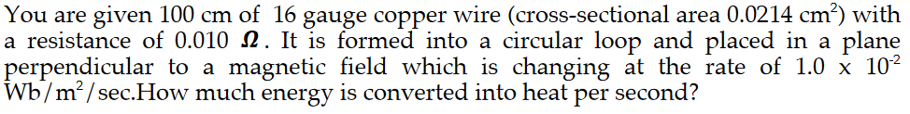
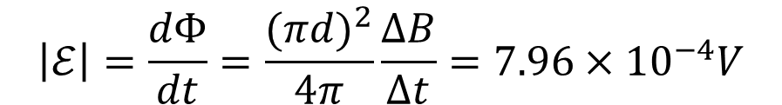

$$\left|ℰ\right|=\frac{dΦ}{dt}=\frac{(πd)^{2}}{4π}\frac{∆B}{∆t}=7.96×{10}^{−4}V$$
$$P=\frac{ℰ^{2}}{R}=6.33{×10}^{−5}J/s$$

Slide 5
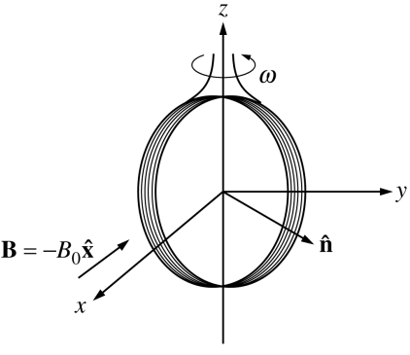
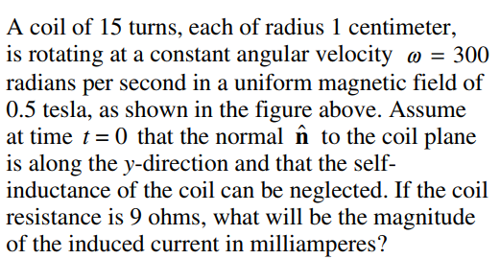





$$t=0, Φ=0$$
$$Φ=NBπr^{2}sin⁡(ωt)$$
$$\frac{dΦ}{dt}=ωNBπr^{2}cos(ωt)$$
$$t=0, \frac{dΦ}{dt}=ωNBπr^{2}$$
$$I=\frac{ℰ}{R}=\frac{ωNBπr^{2}}{R}=78.5 mA$$

Slide 6

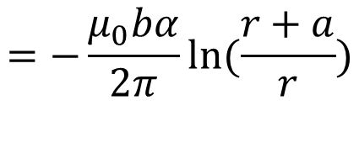
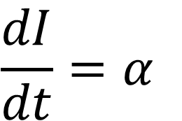
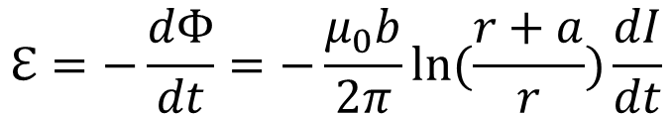
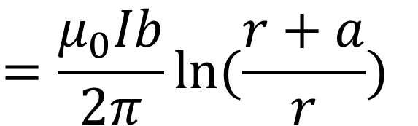
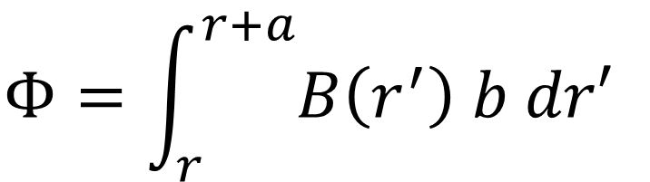
I
A conducting rectangular loop is fixed (i.e. not moving), but the current I flowing in the +y direction is increasing at a constant rate
y
x
x
x
x
x
x
x
r
a
b
x
x
x
x
$$\frac{dI}{dt}=α$$
x
x
x
x
What is the induced emf in the rectangular loop?
$$Φ=\int_{r}^{r+a}{B\left(r^{′}\right) b dr′}$$
$$=\frac{μ_{0}Ib}{2π}ln⁡(\frac{r+a}{r})$$
$$ℇ=−\frac{dΦ}{dt}=−\frac{μ_{0}b}{2π}ln⁡(\frac{r+a}{r})\frac{dI}{dt}$$
$$=−\frac{μ_{0}bα}{2π}ln⁡(\frac{r+a}{r})$$
If α is positive

Slide 7
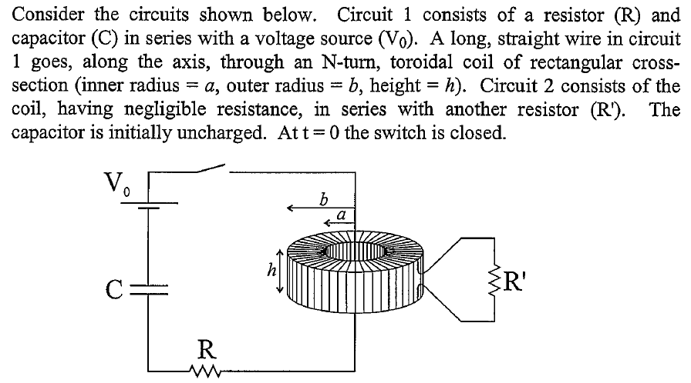

Slide 8

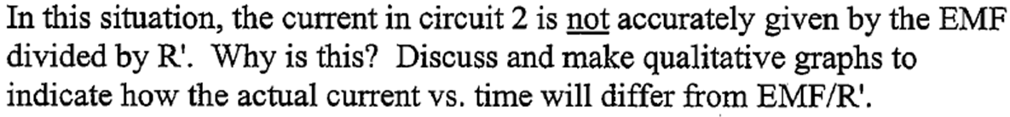
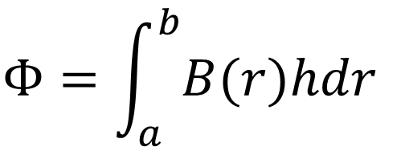
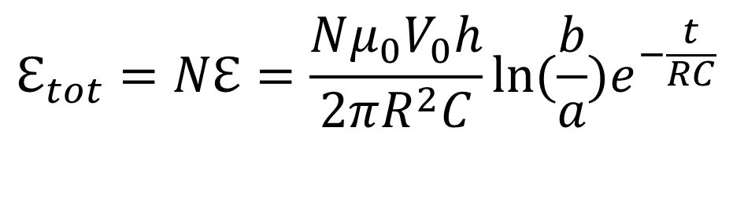
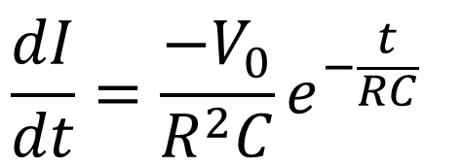
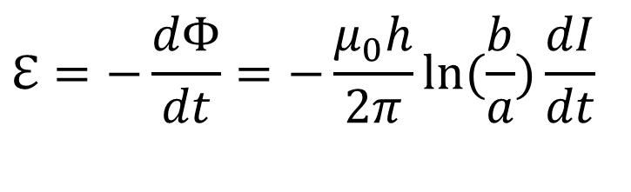
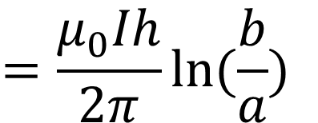
In the R-C circuit, the current is exponentially decaying
I
The magnetic flux in ONE turn of wire loop is given by
x
x
x
x
x
x
x
$$Φ=\int_{a}^{b}{B(r)hdr}$$
$$=\frac{μ_{0}Ih}{2π}ln⁡(\frac{b}{a})$$
a
h
x
x
x
x
b-a
$$ℇ=−\frac{dΦ}{dt}=−\frac{μ_{0}h}{2π}ln⁡(\frac{b}{a})\frac{dI}{dt}$$
$$\frac{dI}{dt}=\frac{−V_{0}}{R^{2}C}e^{−\frac{t}{RC}}$$
x
x
x
$$ℇ_{tot}=Nℇ=\frac{Nμ_{0}V_{0}h}{2πR^{2}C}ln⁡(\frac{b}{a})e^{−\frac{t}{RC}}$$
N-turns in total

Slide 9
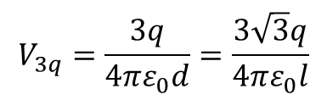

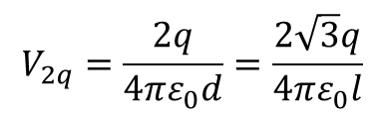

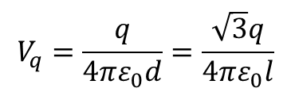

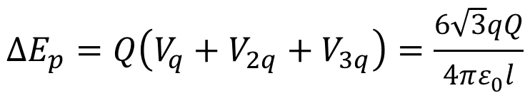
Positive charge of magnitude q, 2q, and 3q are located at the corners of an equilateral triangle as shown above. The sides of the triangle have a length l. What is the minimum amount of work requires to bring a positive charge Q from infinity to the center of the triangle?
The minimum work required is
$$∆E_{p}=Q∆V$$
$$\frac{\sqrt{3}}{3}l$$
$$∆V=V−0=V_{q}+V_{2q}+V_{3q}$$
$$V_{q}=\frac{q}{4πε_{0}d}=\frac{\sqrt{3}q}{4πε_{0}l}$$
$$V_{2q}=\frac{2q}{4πε_{0}d}=\frac{2\sqrt{3}q}{4πε_{0}l}$$
$$V_{3q}=\frac{3q}{4πε_{0}d}=\frac{3\sqrt{3}q}{4πε_{0}l}$$
$$∆E_{p}=Q\left(V_{q}+V_{2q}+V_{3q}\right)=\frac{6\sqrt{3}qQ}{4πε_{0}l}$$

Slide 10







The potential difference across the terminals of a battery is 10 volts if no current is drawn from it. When a 4-ohm resistor is connected across the terminals, a current of 2 amperes is drawn from the battery. This resistor is then removed and replaced with a variable resistor that can have any value of resistance from 0 to ∞. If the internal resistance of the battery is constant, what is the maximum power P the battery can deliver to the variable resistor?
EMF of battery is 10 V
$$\frac{ℰ}{4Ω+r}=2A$$
$$r=1Ω$$
Current with the variable resistor is
$$I=\frac{10 V}{R+1Ω}$$
power on the variable resistor is
$$P=I^{2}R=(\frac{10 }{R+1})^{2}R$$
A maximum requires
$$\frac{dP}{dR}=0$$
$$R=1Ω$$
$$P_{max}=25 W$$

Slide 11
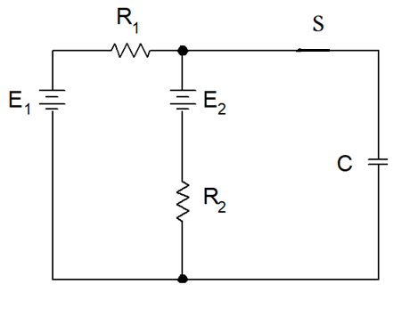
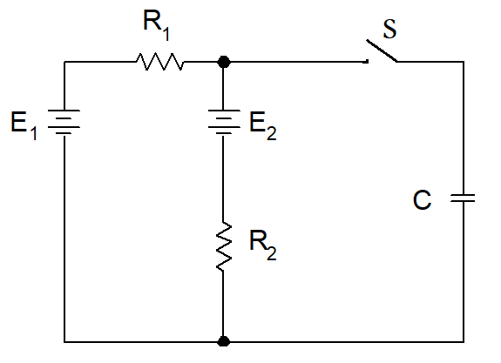

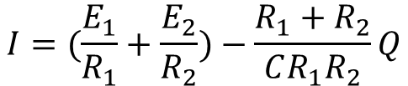
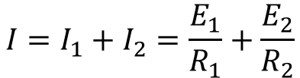
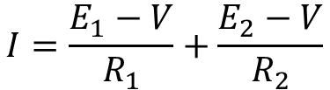

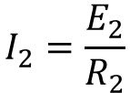
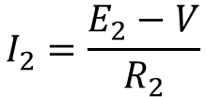


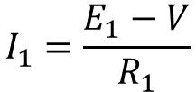
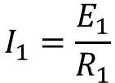

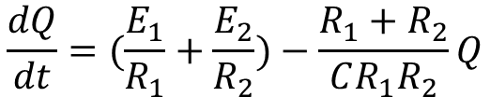
A capacitor is charged with two batteries, as shown in the graph. If initially there is no charge on C,
1, what is the charging current immediately after the switch is closed?
2, can you find the expression of the charge on C as a function of time?
I₁
I
$$I_{1}=\frac{E_{1}}{R_{1}}$$
$${−I_{2}R_{2}+E}_{2}=0$$
I₂
$$V=\frac{Q}{C}$$
0 V
$$I_{2}=\frac{E_{2}}{R_{2}}$$
$$I=I_{1}+I_{2}=\frac{E_{1}}{R_{1}}+\frac{E_{2}}{R_{2}}$$
0 V
Q=0
$$V=\frac{Q}{C}$$
$$I_{1}=\frac{E_{1}−V}{R_{1}}$$
$$I_{2}=\frac{E_{2}−V}{R_{2}}$$
$$I=\frac{E_{1}−V}{R_{1}}+\frac{E_{2}−V}{R_{2}}$$
$$I=(\frac{E_{1}}{R_{1}}+\frac{E_{2}}{R_{2}})−\frac{R_{1}+R_{2}}{CR_{1}R_{2}}Q$$
$$\frac{dQ}{dt}=(\frac{E_{1}}{R_{1}}+\frac{E_{2}}{R_{2}})−\frac{R_{1}+R_{2}}{CR_{1}R_{2}}Q$$
$$Q\left(t\right)=\frac{C(E_{1}R_{2}+E_{2}R_{1})}{R_{1}+R_{2}}−\frac{C(E_{1}R_{2}+E_{2}R_{1})}{R_{1}+R_{2}}e^{−\frac{t}{τ}}$$
$$τ=\frac{CR_{1}R_{2}}{R_{1}+R_{2}}$$

Slide 12
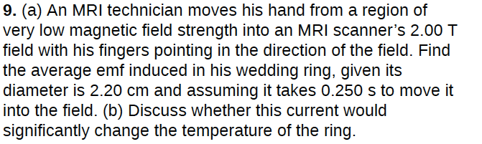





emf :
maximum field:
maximum flux:
minimum flux:

Slide 13

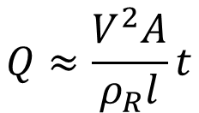

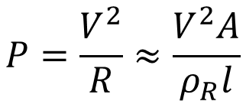


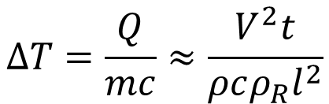



$$P=\frac{V^{2}}{R}≈\frac{V^{2}A}{ρ_{R}l}$$
$$Q≈\frac{V^{2}A}{ρ_{R}l}t$$
Total heat
Specific heat of gold:
$$c=5 kJ/(kg∙K)$$
$$∆T=\frac{Q}{mc}≈\frac{V^{2}t}{ρcρ_{R}l^{2}}$$
Change of temperature
$$V=3mV$$
$$t=0.25s$$
$$ρ=19×{10}^{3}kgm^{−3}$$
$$ρ_{R}=22.1×{10}^{−9}Ωm$$
$$l=2π×0.022m$$
$$∆T≈2.2×{10}^{−4}K$$

Slide 14
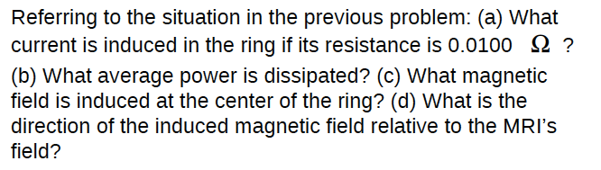





power dissipated:
field inside the ring:
opposite to the magnetic field of the MRI

